Slide 1
Octocoral Field Guide:
Kimberley, Western Australia
Cnidaria – Octocorallia
Western Australian Museum Reference Collection
Monika Bryce
Specimens were collected during the Western Australian Marine Science Institution (WAMSI) Kimberley biodiversity cruises 2015-2016 and are held in the collections of the Western Australian Museum (WAM).
This field guide is intended to facilitate field identification of Kimberley specimens collected from depths of 12-100 metres using visual and microscopic characters. The guide will also aid future field monitoring and additions to biodiversity collections. Locations of fieldtrips are provided below.
Specimens were identified to species or OTU (Operational Taxonomic Unit).
Contact: Dr Monika Bryce: Western Australian Museum, 49 Kew Street Welshpool, 6106
Telephone | 08 9212 3816 Fax | 08 9212 3882 Email | monika.bryce@museum.wa.gov.au
Text and photographs: Monika Bryce
© WA Museum 2017
This manual has been created for non-commercial purposes

Slide 2
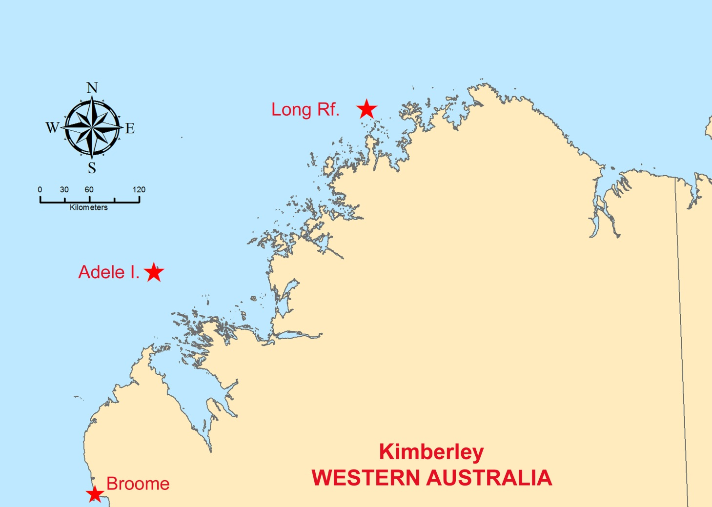
Sampling locations
WAMSI Expeditions:
Trip 1: Camden Sound
Trip 2: Maret Islands
Trip 3: Eclipse Islands
Trip 4: Lynher Bank

Slide 3
Species name (Author, date)
Key to plates
Taxa
STOLONIFERA
CLAVULARIIDAE
COELOGORGIIDAE
TUBIPORIDAE
ALCYONIINA
ALCYONIIDAE
NEPHTHEIDAE
NIDALIIDAE
PARALCYONIIDAE
XENIIDAE
SCLERAXONIA
BRIAREIDAE
ANTHOTHELIDAE
SUBERGORGIIDAE
MELITHAEIDAE
PARISIDIDAE
HOLOXONIA
ACANTHOGORGIIDAE
PLEXAURIDAE
GORGONIIDAE
CALCAXONIA
ELLISELLIDAE
IFALUKELLIDAE
PRIMNOIDAE
ISIDIDAE
Specimen
Image
Specimen
Image
Subclass: Colour coded (table)
Family: Colour coded (table)
Genus: Name
Ref. #: WAM number
Physical Description:
Growth form:
Sclerites:
Colour:
Size:
Habitat and abundance:
General comments
Sclerite image(s)

Slide 4
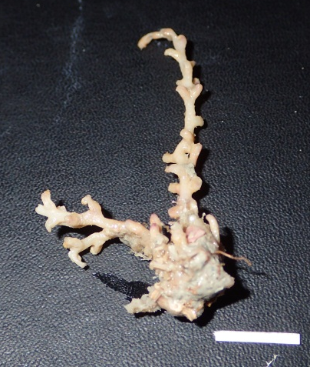
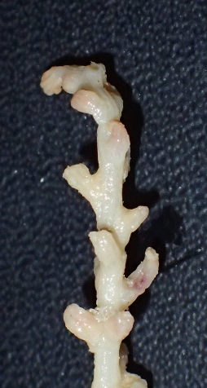
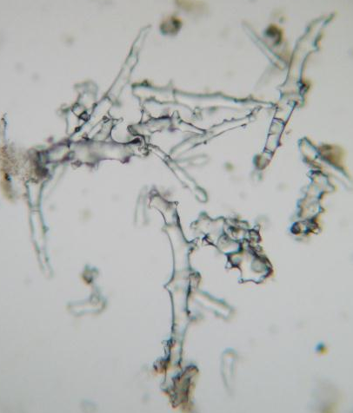
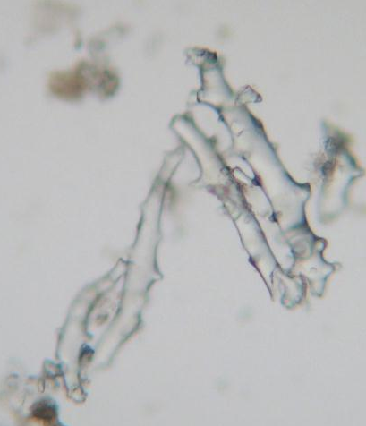
Carijoa sp.1
Subclass: STOLONIFERA
Family: CLAVULARIIDAE
Genus: Carijoa
Ref. #: WAM Z90252
Physical description:
Growth form: long, thin with large polyps.
Sclerites: long, slender, thorned rods.
Colour: colony beige. Sclerites colourless.
Size: 10 cm.
Habitat and abundance:
Turbid coastal areas, often overgrown by encrusting sponges.

Slide 5
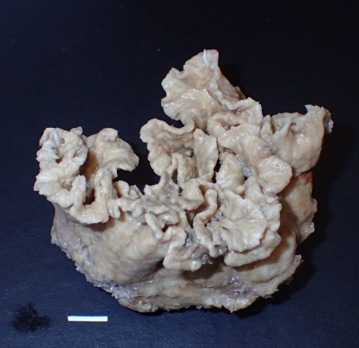
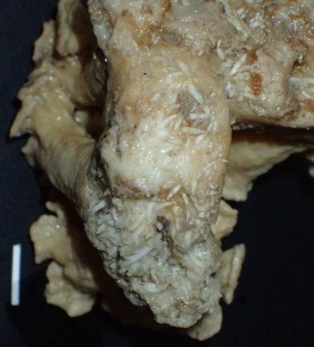
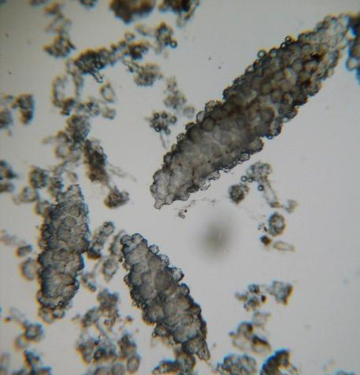
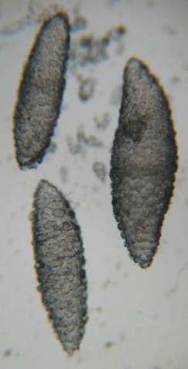
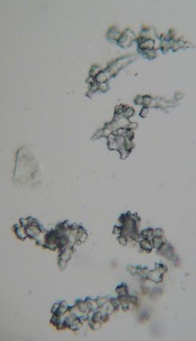
Sinularia sp.1
Subclass: ALCYONIINA
Family: ALCYONIIDAE
Genus: Sinularia
Ref. #: WAM Z94538
Physical description:
Growth form: massive, dish-like and firm.
Sclerites: large, warty spindles and small clubs with distinct heads.
Colour: colony light brown. Sclerites colourless.
Size: 15 cm.
Habitat and abundance:
Common.

Slide 6
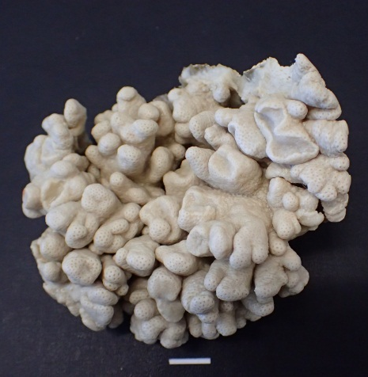
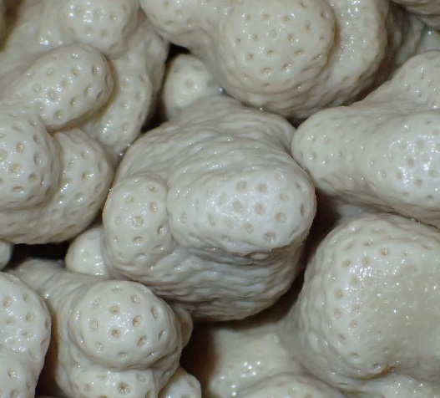

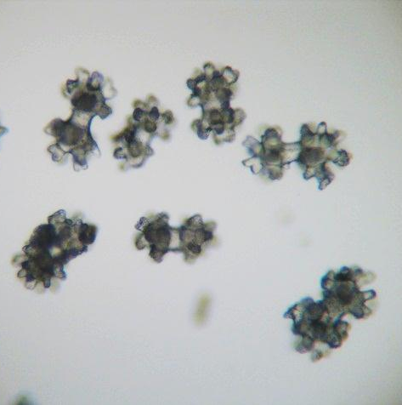
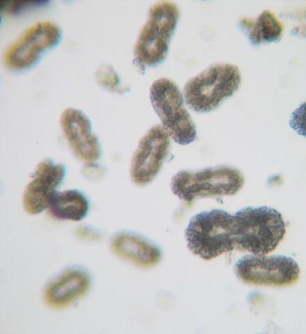
Cladiella sp.1
Subclass: ALCYONIINA
Family: ALCYONIIDAE
Genus: Cladiella
Ref. #: WAM Z94707
Physical description:
Growth form: massive, lobate, encrusting and firm.
Sclerites: double-heads.
Polyp sclerites: figure-eights.
Colour: colony cream. Sclerites colourless.
Size: 30 cm.
Habitat and abundance:
Generally common.

Slide 7
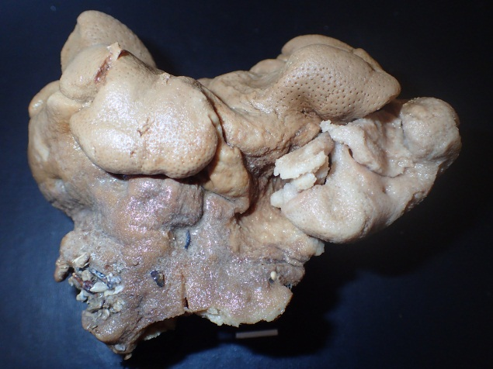
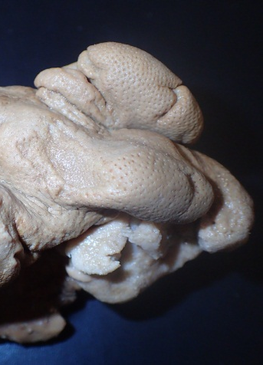
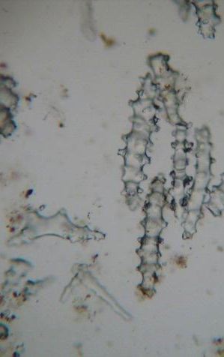
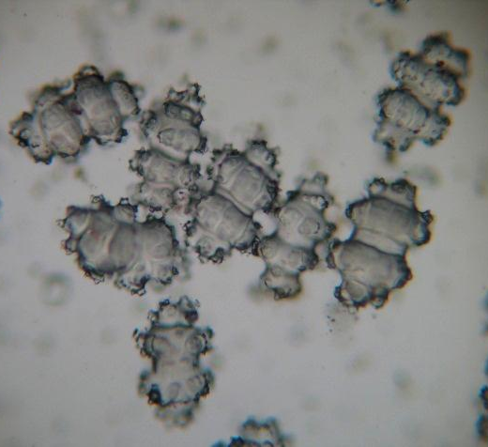
Lobophytum cf. crassum Von Marenzeller, 1886
Subclass: ALCYONIINA
Family: ALCYONIIDAE
Genus: Lobophytum
Ref. #: WAM Z90311
Physical description:
Growth form: massive, lobate, encrusting and firm.
Sclerites: lobes with spindles. Base with ovals with two distinct girdles.
Colour: colony brown. Sclerites colourless.
Size: 20 cm.
Habitat and abundance:
Widespread in the Indo-Pacific.

Slide 8
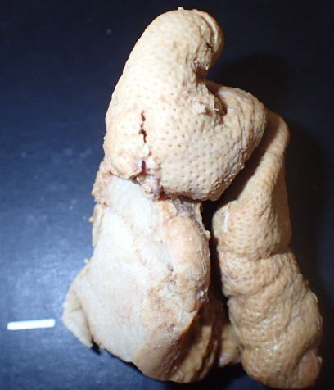
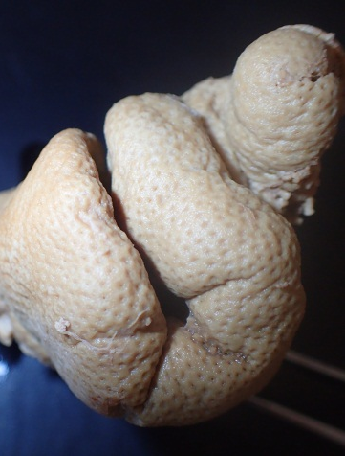
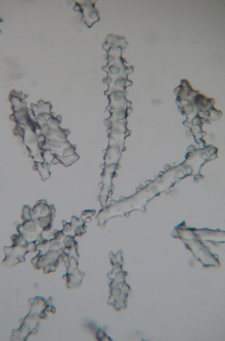
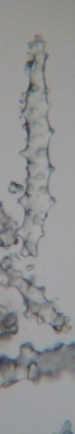
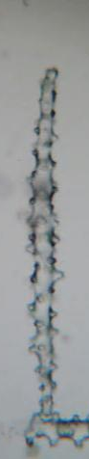
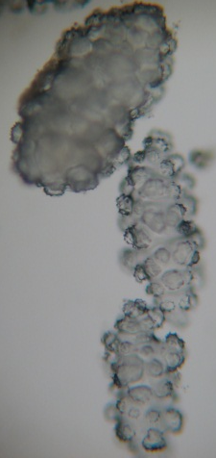
Sarcophyton cf. trocheliophorum Von Marenzeller, 1886
Subclass: ALCYONIINA
Family: ALCYONIIDAE
Genus: Sarcophyton
Ref. #: WAM Z94706
Physical description:
Growth form: massive, lobate and firm.
Sclerites: lobe surface: short and long clubs. Lobe interior: spindles. Base surface: long and thin spindles. Base interior: short, robust spindles.
Colour: colony brown. Sclerites colourless.
Size: 10 cm.
Habitat and abundance:
Widespread in the Indian Ocean.

Slide 9
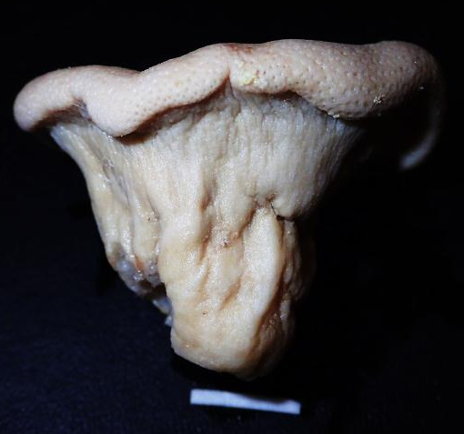
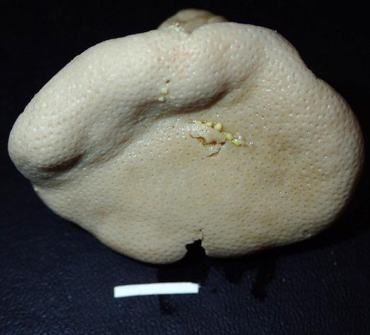
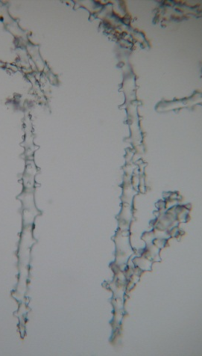
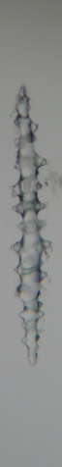
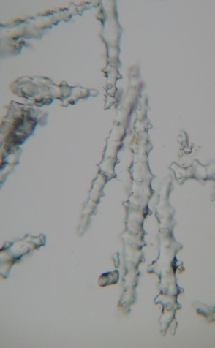
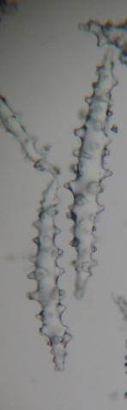
Sarcophyton sp. 2
Subclass: ALCYONIINA
Family: ALCYONIIDAE
Genus: Sarcophyton
Ref. #: WAM Z94710
Physical description:
Growth form: massive, mushroom-shaped, firm.
Sclerites: surface and interior sclerites are thin, long clubs and thin spindles.
Colour: colony cream. Sclerites colourless.
Size: 30 cm.
Habitat and abundance:
Generally common.

Slide 10
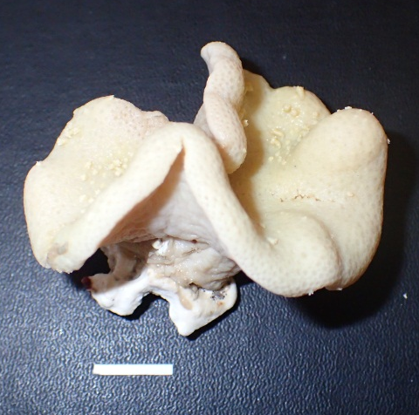
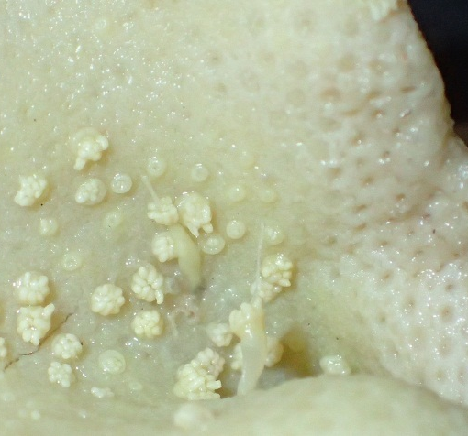
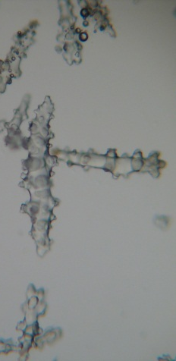
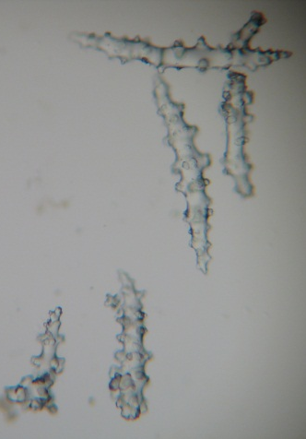
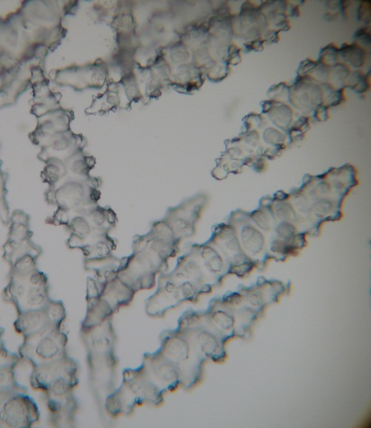
Sarcophyton sp. 3
Subclass: ALCYONIINA
Family: ALCYONIIDAE
Genus: Sarcophyton
Ref. #: WAM Z94705
Physical description:
Growth form: mushroom-like, short stalk.
Sclerites: surface sclerites are clubs and spindles. Base sclerites are wide, robust spindles.
Colour: colony cream. Sclerites colourless.
Size: 30 cm.
Habitat and abundance:
Generally common.

Slide 11
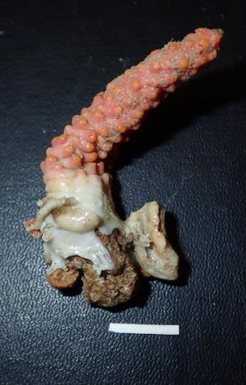
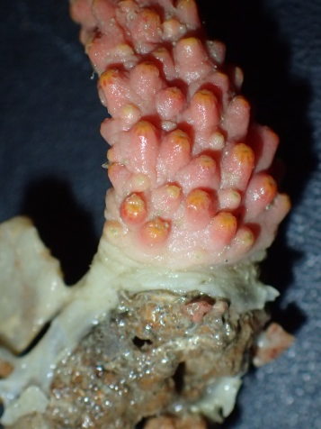
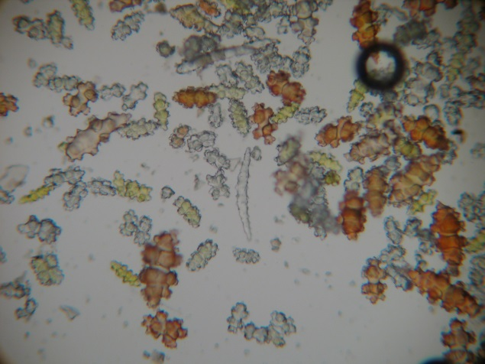
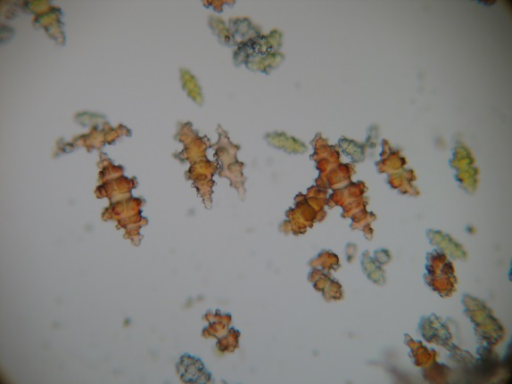
Eleutherobia sp.1
Subclass: ALCYONIINA
Family: ALCYONIIDAE
Genus: Eleutherobia
Ref. #: WAM Z52156
Physical description:
Growth form: cylindrical, erect, digitate and unbranched.
Sclerites: 8-radiates and capstans. Polyps: spindles.
Colour: colony pink. Surface sclerites red. Polyp sclerites in introvert yellow and points and crowns colourless.
Size: 5 cm.
Habitat and abundance:
Rare.

Slide 12
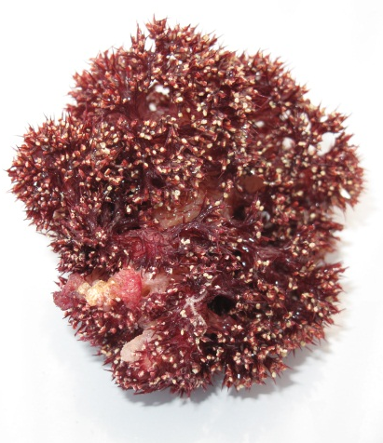
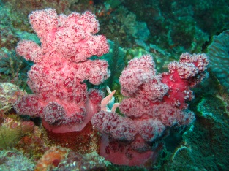
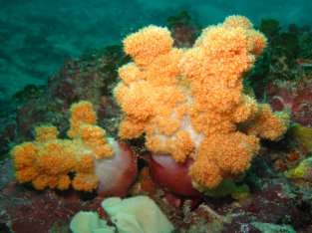
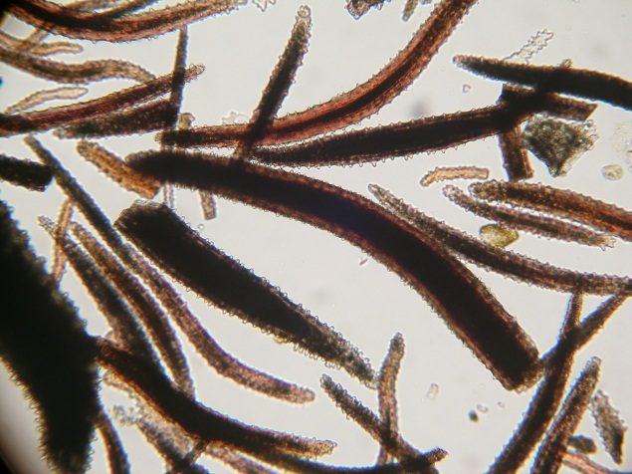
Dendronephthya spp.
Subclass: ALCYONIINA
Family: NEPHTHEIDAE
Genus: Dendronephthya
Ref. #: WAM Z90241
Physical description:
Growth form: branched, tree-like with a stem with polyp bunches. High level of intra-colony and intra-species variability. Spiky.
Sclerites: spindles.
Colour: colony various - often bright red, orange, purple, yellow, pink. Sclerites coloured with the stem often colourless or white.
Size: from 5 cm – 2 m.
Habitat and abundance:
Very common.

Slide 13
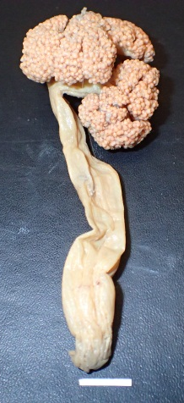
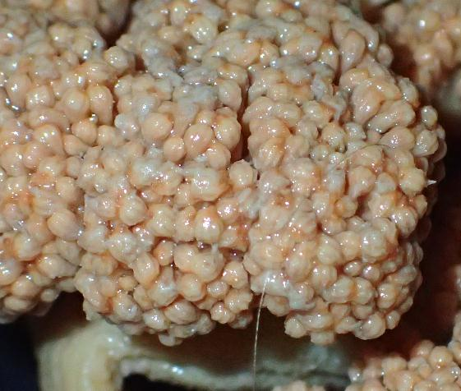
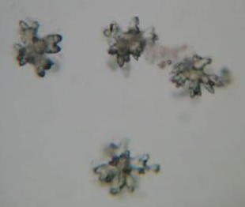
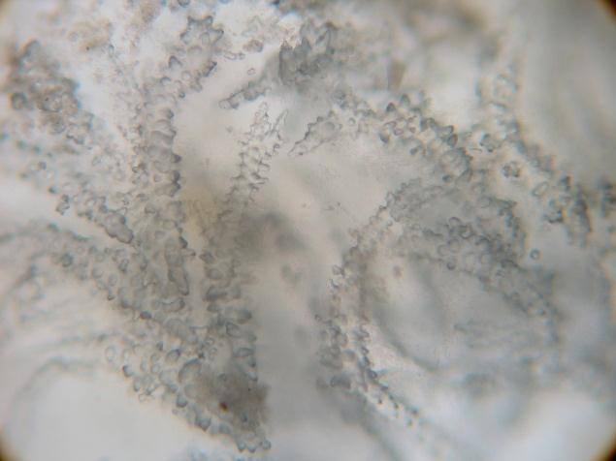
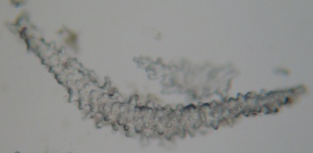
Umbellulifera spp.
Subclass: ALCYONIINA
Family: NEPHTHEIDAE
Genus: Umbellulifera
Ref. #: WAM Z90273
Physical description:
Growth form: tree-like with a long, bare stalk and a branched, umbellate polyp bearing region.
Sclerites: asymmetrical capstans and spindles with long warts in the surface. Polyp sclerites: stick-shaped with tall warts.
Colour: colony light brown. Sclerites colourless.
Size: 5 cm.
Habitat and abundance:
Rare.

Slide 14
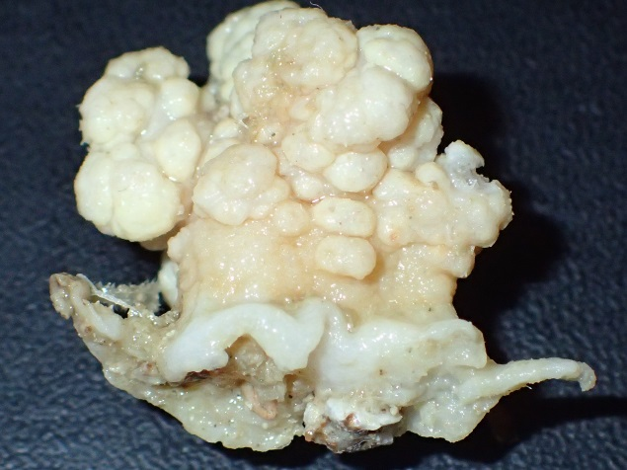
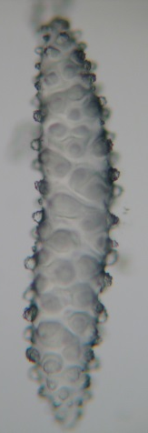

Scleronephthya sp. 1
Subclass: ALCYONIINA
Family: NEPHTHEIDAE
Genus: Scleronephthya
Ref. #: WAM Z91984
Physical description:
Growth form: highly contractile and lumpy when contracted; arborescent with sparsely subdivided branches when expanded.
Sclerites: large, warty spindles on colony surface. Polyps: spindles, slightly club-shaped.
Colour: colony white. Sclerites colourless.
Size: 5 cm.
Habitat and abundance:
Uncommon; in current exposed areas.

Slide 15




Stereonephthya imbricans Thomson & Dean, 1931
Subclass: ALCYONIINA
Family: NEPHTHEIDAE
Genus: Stereonephthya
Ref. #: WAM Z91882
Physical description:
Growth form: tree-like, branched polyp bearing region, rigid stem, each polyp with a stalk and ensheating supporting bundle around an inward bend polyp.
Sclerites: massive, slightly curved spindles on colony surface. Polyps: bent spindles.
Colour: colony cream. Sclerites colourless
Size: 5 cm.
Habitat and abundance:
Uncommon: In current exposed areas.

Slide 16




Capnella sp. 1
Subclass: ALCYONIINA
Family: NEPHTHEIDAE
Genus: Capnella
Ref. #: WAM Z96415
Physical description:
Growth form: tree-like with a stem and polyp bearing lobes (pine-cones).
Sclerites: spiny and leafy club spindles.
Colour: colony grey. Sclerites colourless.
Size: 5 cm.
Habitat and abundance:
Relatively common.

Slide 17





Nephthyigorgia sp.1
Subclass: ALCYINIINA
Family: NIDALIIDAE
Genus: Nephthyigorgia
Ref. #: WAM Z92036
Physical description:
Growth form: tree-like, branched polyp bearing region, firm.
Sclerites: spindels. Polyps: collarets and 3-4 points with approx. 4 per crown.
Colour: colony white. Polyp sclerites orange, red or colourless.
Size: 20 cm.
Habitat and abundance:
Rare, muddy environments.

Slide 18



Nephthyigorgia kükenthali (Broch, 1916)
Subclass: ALCYINIINA
Family: NIDALIIDAE
Genus: Nephthyigorgia
Ref. #: WAM Z96418
Physical description:
Growth form: arborescent with a stem and a branched polyp bearing region, very firm and rough.
Sclerites: massive spindles. Polyps: collarets and points.
Colour: colony dark red, often covered with whitish membrane. Sclerites red.
Size: a few to 20 cm.
Habitat and abundance:
Relatively rare, muddy and sandy substrate.

Slide 19




Chironephthya sp.1
Subclass: ALCYINIINA
Family: NIDALIIDAE
Genus: Chironephthya
Ref. #: WAM Z94607
Physical description:
Growth form: tree-like with a long stem and a branched polyp bearing region, firm.
Sclerites: spindles on stem and branches. Polyps: shelf-like calyces, collaret and points.
Colour: colony white with red polyps. Large spindles colourless and polyp sclerites red.
Size: 10 cm.
Habitat and abundance:
Rare.

Slide 20




Chironephthya sp. 2
Subclass: ALCYINIINA
Family: NIDALIIDAE
Genus: Chironephthya
Ref. #: WAM Z92210
Physical description:
Growth form: arborescent, massive stem, profusely branched and firm.
Sclerites: large spindles on stem and branches. Polyps: shelf-like calyces with ‘pointed ears’, collaret and points.
Colour: White with red branch tips. Polyps yellow with red armature and yellow tentacle sclerites. Large surface spindles colourless and smaller spindles at the tips are red.
Size: 10 cm.
Habitat and abundance:
Rare, on walls and overhangs.

Slide 21





Chironephthya sp. 3
Subclass: ALCYINIINA
Family: NIDALIIDAE
Genus: Chironephthya
Ref. #: WAM Z62160
Physical description:
Growth form: arborescent, branched and firm.
Sclerites: spindles on stem and branches. Polyps: shelf-like calyces, collaret and points.
Colour: colony orange. Sclerites light yellow and colourless.
Size: 5 cm.
Habitat and abundance:
Rare.

Slide 22




Siphonogorgia sp.1
Subclass: ALCYINIINA
Family: NIDALIIDAE
Genus: Siphonogorgia
Ref. #: WAM Z92157
Physical description:
Growth form: colony fragment.
Sclerites: large spindles on stem and branches. Polyps: small, shelf-like calyces, collaret and points. Polyp sclerites: flattened with spiky tips.
Colour: Colony white with orange polyps. Spindles colourless. Polyp sclerites light orange with high amarture (crown approx. 12 rows)
Size: 5 cm.
Habitat and abundance:
Rare.

Slide 23





Siphonogorgia sp. 2
Subclass: ALCYINIINA
Family: NIDALIIDAE
Genus: Siphonogorgia
Ref. #: WAM Z92127
Physical description:
Growth form: arborescent.
Sclerites: large spindles on stem and branches. Polyps: calyces with small spindles, collaret and points.
Colour: colony bright red with white polyps. Large surface spindles orange-red and smaller calyx spindles bright red. Polyp sclerites bright orange.
Size: 5 cm.
Habitat and abundance:
Rare.

Slide 24





Studeriotes crassa Kükenthal, 1910
Subclass: ALCYINIINA
Family: PARALCYONIIDAE
Genus: Studeriotes
Ref. #: WAM Z94688
Physical Description:
Growth form: hollow container-like cup with stiff walls and soft, tree-like polyp bearing region, which can fully retract into the base.
Sclerites: Long curvy spindles, and small polyp spindles. Polyp body with supporting bundles.
Colour: colony brown. Sclerites colourless
Size: 10 cm retracted, 20 cm expanded.
Habitat and abundance:
Relatively rare, muddy and sandy substrate.

Slide 25




Alertigorgia orientalis (Ridley, 1884)
Subclass: SCLERAXONIA
Family: ANTHOTHELIDAE
Genus: Alertigorgia
Ref. #: WAM Z90323
Physical description:
Growth form: bushy, with cylindrical or flattened branches. Colonies break easily as the axis consists only of sclerites.
Sclerites: wide spindles and ovals in the cortex and small needle-like forms and rods in the medulla.
Colour: colony cream underwater. Brown with cream axis above water. Sclerites colourless.
Size: 30 cm.
Habitat and abundance:
Generally common.

Slide 26



Alertigorgia sp. 1
Subclass: SCLERAXONIA
Family: ANTHOTHELIDAE
Genus: Alertigorgia
Ref. #: WAM Z94667
Physical description:
Growth form: bushy, but sparsely branched. Breaks easily.
Sclerites: plumb spindles in the cortex and small needle-like forms and rods in the medulla.
Colour: colony cream. Sclerites colourless.
Size: 30 cm.
Habitat and abundance:
Rare, colony is overgrowing a sponge.

Slide 27



Iciligorgia brunnea (Nutting, 1911)
Subclass: SCLERAXONIA
Family: ANTHOTHELIDAE
Genus: Iciligorgia
Ref. #: WAM Z90321
Physical description:
Growth form: tree-like, branched more or less in one plane, stiff colonies. Branch ends are grooved and swollen. Colonies break very easily as the axis consists only of sclerites.
Sclerites: spindles and ovals in the cortex and long needle-like forms in the medulla.
Colour: colony cream and brown. Sclerites colourless
Size: 30 cm.
Habitat and abundance:
Widespread, muddy environments.

Slide 28





Solenocaulon tortuosum Gray, 1862
Subclass: SCLERAXONIA
Family: ANTHOTHELIDAE
Genus: Solenocaulon
Ref. #: WAM Z92012
Physical description:
Growth form: tree-like, in one plane and firm. Branches open with flattened ends. Colonies break very easily as the axis consists only of sclerites.
Sclerites: spindles, some triangular and ovals in the cortex, and long needle-like forms in the medulla.
Colour: colony reddish. Sclerites colourless in medulla, red in the cortex.
Size: 20 cm.
Habitat and abundance:
Uncommon, muddy and current driven environments.

Slide 29





Solenocaulon grayi Studer, 1878
Subclass: SCLERAXONIA
Family: ANTHOTHELIDAE
Genus: Solenocaulon
Ref. #: WAM Z92195
Physical description:
Growth form: tree-like, in one plane, firm. Branches open with flattened ends and hollow in upper parts. Colonies break very easily as the axis consists only of sclerites.
Sclerites: spindles and ovals in the cortex and long needle-like forms in the medulla
Colour: colony brown. Sclerites colourless and light red.
Size: 20 cm.
Habitat and abundance:
Uncommon, muddy environments.

Slide 30




Solenocaulon cf. simplex Brundin, 1896
Subclass: SCLERAXONIA
Family: ANTHOTHELIDAE
Genus: Solenocaulon
Ref. #: WAM Z92084
Physical description:
Growth form: tree-like, hollow, cylindrical stem without branching, but with big openings from which small, shovel-like flattened branches radiate. Branches open with polyps densely arranged at the tips and back side. Polyps also in groups on the stem.
Sclerites: long spindles with smaller spiky spindles in the cortex and long needle-like forms in the medulla.
Colour: colony grey. Sclerites colourless.
Size: 20 cm.
Habitat and abundance:
Rare, muddy environments.

Slide 31




Subergorgia suberosa (Pallas, 1766)
Subclass: SCLERAXONIA
Family: SUBERGORGIIDAE
Genus: Subergorgia
Ref. #: WAM Z92181
Physical description:
Growth form: bushy, dichotomously branched, branches with furrows on one side.
Sclerites: small warty spindles and fused medulla sclerites.
Colour: colony red brown. Sclerites colourless and orange.
Size: 50 cm.
Habitat and abundance:
Generally common.

Slide 32




Annella reticulata (Ellis & Solander, 1786)
Subclass: SCLERAXONIA
Family: SUBERGORGIIDAE
Genus: Annella
Ref. #: WAM Z92165
Physical description:
Growth form: reticulate fan, polygonal mesh.
Sclerites: warty spindles and small double wheels, fused medulla sclerites.
Colour: colony brown. Sclerites colourless.
Size: 20 cm (can reach up to 2 m).
Habitat and abundance:
Generally common in current-swept environments.

Slide 33



Melithaea spp.
Subclass: SCLERAXONIA
Family: MELITHAEIDAE
Genus: Melithaea
Ref. #: WAM Z92082
Physical description:
Growth form: fans, sometimes net-like, in one plane, dichotomously branched, segmented axis with swollen nodes at branching points.
Sclerites: capstans, knobbed clubs with or without leafy processes, smooth rods in the axis.
Colour: colonies have various colours, often bright yellow, orange, red, purple. Sclerites in the polyps often have a different colour to the sclerites in the branches.
Size: 5 cm to 2 m.
Habitat and abundance:
Common.

Slide 34



Parisis fructicosa Verrill, 1864
Subclass: SCLERAXONIA
Family: PARISIDIDAE
Genus: Parisis
Ref. #: WAM Z96376
Physical description:
Growth form: bushy, but branched in one plane. Axis with grooved nodes and internodes.
Sclerites: larger plate-like sclerites and smaller irregular forms.
Colour: colony white with nodes brown and internodes white. Sclerites colourless.
Size: 20 cm.
Habitat and abundance:
Rare in shallow water, often encrusted with sponges.

Slide 35




Acanthogorgia sp. 1
Subclass: HOLOXONIA
Family: ACANTHOGORGIIDAE
Genus: Acanthogorgia
Ref. #: WAM Z90201
Physical description:
Growth form: fan-like, in one plane with thin surface tissue.
Sclerites: spindles with small warts. Polyps: large boomerang-shaped sclerites.
Colour: yellowish polyps and black axis. Sclerites colourless.
Size: up to 25 cm.
Habitat and abundance:
Not very abundant.

Slide 36




Acanthogorgia sp. 2
Subclass: HOLOXONIA
Family: ACANTHOGORGIIDAE
Genus: Acanthogorgia
Ref. #: WAM Z92000
Physical description:
Growth form: fan-like, in one plane with thin surface tissue
Sclerites: spindles with small warts. Polyp sclerites: curved and boomerang-shaped.
Colour: light brown polyps and black axis. Sclerites colourless.
Size: 15 cm.
Habitat and abundance:
Not very abundant.

Slide 37





Acanthogorgia sp. 3
Subclass: HOLOXONIA
Family: ACANTHOGORGIIDAE
Genus: Acanthogorgia
Ref. #: WAM Z92206
Physical description:
Growth form: fan-like, in one plane
Sclerites: spindles with small warts. Polyp sclerites: large and boomerang-shaped. Spindles at the top of the polyp are very long and form a spiny ‘crown’.
Colour: colony black with black axis. Sclerites colourless.
Size: up to 25 cm.
Habitat and abundance:
Not very abundant.

Slide 38




Acanthogorgia sp. 4
Subclass: HOLOXONIA
Family: ACANTHOGORGIIDAE
Genus: Acanthogorgia
Ref. #: WAM Z91985
Physical description:
Growth form: fan-like, in one plane with thin surface tissue.
Sclerites: spindles with small warts. Polyp sclerites: boomerang-shaped often with a smooth and a spiny part - spindles at the top of the polyp are very long and form a spiny ‘crown’.
Colour: colony light brown with brown axis. Polyps white. Sclerites colourless.
Size: 5 cm.
Habitat and abundance:
Not very abundant.

Slide 39




Acanthogorgia sp. 5
Subclass: HOLOXONIA
Family: ACANTHOGORGIIDAE
Genus: Acanthogorgia
Ref. #: WAM Z91995
Physical description:
Growth form: fan-like, in one plane with thin surface tissue.
Sclerites: spindles with small warts. Polyp sclerites: massive, boomerang-shaped.
Colour: light brown with black axis. Sclerites colourless.
Size: up to 25 cm.
Habitat and abundance:
Uncommon.

Slide 40




Anthogorgia sp. 2
Subclass: HOLOXONIA
Family: ACANTHOGORGIIDAE
Genus: Acanthogorgia
Ref. #: WAM Z90200
Physical description:
Growth form: fan-like, in one plane.
Sclerites: warted spindles.
Colour: colony cream with black axis. Sclerites colourless.
Size: up to 10 cm.
Habitat and abundance:
Rare.

Slide 41




Muricella sp. 1
Subclass: HOLOXONIA
Family: ACANTHOGORGIIDAE
Genus: Muricella
Ref. #: WAM Z91416
Physical description:
Growth form: fan-like nets, in one plane.
Sclerites: small capstans and large warted spindles.
Colour: colony brown with black axis. Sclerites colourless.
Size: up to 10 cm (may reach over 1 m).
Habitat and abundance:
Rare.

Slide 42





Euplexaura erecta Kückenthal,1908
Subclass: HOLOXONIA
Family: PLEXAURIDAE
Genus: Euplexaura
Ref. #: WAM Z96277
Physical description:
Growth form: fan in one plane with slightly swollen branch tips.
Sclerites: spindles, ovals, and sub-spheroidal sclerites.
Colour: colony grey. Sclerites colourless.
Size: up to 30 cm.
Habitat and abundance:
Abundant.

Slide 43




Euplexaura sp. 2
Subclass: HOLOXONIA
Family: PLEXAURIDAE
Genus: Euplexaura
Ref. #: WAM Z91991
Physical description:
Growth form: fan in one plane, smooth surface.
Sclerites: spindles, ovals and sub-spheroidal sclerites.
Colour: colony brown. Sclerites colourless.
Size: 10 cm.
Habitat and abundance:
Generally abundant.

Slide 44




Bebryce sp. 1
Subclass: HOLOXONIA
Family: PLEXAURIDAE
Genus: Bebryce
Ref. #: WAM Z92113
Physical description:
Growth form: bushy, velvety surface.
Sclerites: rosettes, spiny clubs, crosses. Polyp sclerites: curved and bow-shaped spindles.
Colour: colony grey. Sclerites colourless.
Size: 10 cm.
Habitat and abundance:
Uncommon, often overgrown by encrusting sponges.

Slide 45






Echinomuricea cf. indomalaccensis Ridley 1884
Subclass: HOLOXONIA
Family: PLEXAURIDAE
Genus: Echinomuricea
Ref. #: WAM Z90194
Physical description:
Growth form: colonies with whip-like branches in one plane.
Sclerites: thornscales with a single spine and distinct warty base. Polyp sclerites: smooth rods.
Colour: colony brick red and thornscales red. Polyp sclerites red.
Size: 30 cm.
Habitat and abundance:
Rare, found in clear and turbid environments.

Slide 46





Echinomuricea sp.2
Subclass: HOLOXONIA
Family: PLEXAURIDAE
Genus: Echinomuricea
Ref. #: WAM Z90159
Physical description:
Growth form: fan in one plane.
Sclerites: thornscales with a single spine and modified forms.
Colour: colony grey. Sclerites colourless.
Size: 10 cm.
Habitat and abundance:
Rare.

Slide 47



Echinomuricea cf. pulchra Nutting 1910
Subclass: HOLOXONIA
Family: PLEXAURIDAE
Genus: Echinomuricea
Ref. #: WAM Z94658
Physical description:
Growth form: whip-like colonies attached to shells.
Sclerites: thornscales with a single long spine and distinct warty base.
Colour: colony brick red. Sclerites colourless and thornscales red. Polyp sclerites bright red.
Size: 10 cm.
Habitat and abundance:
Uncommon.

Slide 48



Paracis sp. 1
Subclass: HOLOXONIA
Family: PLEXAURIDAE
Genus: Paracis
Ref. #: WAM Z92168
Physical description:
Growth form: fan in one plane.
Sclerites: flattened spindles and thornscales. Polyp sclerites: bow and hockey-stick shaped spindles.
Colour: colony dark brick red. Sclerites colourless
Size: 10 cm.
Habitat and abundance:
Uncommon, often in deeper waters.

Slide 49





Villogorgia sp. 1
Subclass: HOLOXONIA
Family: PLEXAURIDAE
Genus: Villogorgia
Ref. #: WAM Z92129
Physical description:
Growth form: fan in one plane.
Sclerites: triangular with broad, flat bases and short, spiny-leafy projections (calicular thornscales) and thornspindles. Polyp sclerites: bow and hockey-stick shaped spindles.
Colour: colony brick red and grey with brown axis. Sclerites colourless.
Size: 10 cm.
Habitat and abundance:
Uncommon, often in deeper waters.

Slide 50






Echinogorgia sp. 1
Subclass: HOLOXONIA
Family: PLEXAURIDAE
Genus: Echinogorgia
Ref. #: WAM Z90183
Physical description:
Growth form: net-like fan in one plane, short side branches, not fused.
Sclerites: roundish thornscales
Colour: colony grey. Sclerites colourless.
Size: 15 cm.
Habitat and abundance:
The genus is common and appears to be widespread in turbid, current driven environments.

Slide 51





Echinogorgia sp. 2
Subclass: HOLOXONIA
Family: PLEXAURIDAE
Genus: Echinogorgia
Ref. #: WAM Z96311
Physical description:
Growth form: net-like fan in one plane with short side branches - few fused.
Sclerites: spiky thornscales, massive blade-like projections and massive root structures.
Colour: colony orange. Sclerites light brown.
Size: 15 cm.
Habitat and abundance:
The genus is common and appears to be widespread in turbid, current driven environments.

Slide 52




Echinogorgia sp. 3
Subclass: HOLOXONIA
Family: PLEXAURIDAE
Genus: Echinogorgia
Ref. #: WAM Z90185
Physical description:
Growth form: net-like fan in one plane, short side branches - not fused.
Sclerites: thornscales, many forming roundish, thorny blocks.
Colour: colony orange with black axis. Sclerites orange and light red.
Size: 30 cm.
Habitat and abundance:
The genus is common and appears to be widespread in turbid, current driven environments.

Slide 53





Echinogorgia cf. reticulata (sp. 4)
Subclass: HOLOXONIA
Family: PLEXAURIDAE
Genus: Echinogorgia
Ref. #: WAM Z94616
Physical description:
Growth form: net-like fan in one plane, short side branches - few fused.
Sclerites: thornscales with distinct massive thorn-like projections.
Colour: colony brick red with black axis. Sclerites red.
Size: 30 cm.
Habitat and abundance:
The genus is common and appears to be widespread in turbid, current driven environments.

Slide 54






Echinogorgia sp. 5
Subclass: HOLOXONIA
Family: PLEXAURIDAE
Genus: Echinogorgia
Ref. #: WAM Z96291
Physical description:
Growth form: net-like fan in one plane, short side branches - few fused.
Sclerites: often wide thornscales with rounded thorn-like projections and massive root structure. Polyp: spindles.
Colour: colony dark brown. Thornscale sclerites colourless. Polyp spindles colourless or light red.
Size: 20 cm.
Habitat and abundance:
The genus is common and appears to be widespread in turbid, current driven environments.

Slide 55




Echinogorgia sp. 6
Subclass: HOLOXONIA
Family: PLEXAURIDAE
Genus: Echinogorgia
Ref. #: WAM Z96260
Physical description:
Growth form: net-like fan in one plane, short side branches - few fused.
Sclerites: thornscales; small, rounded blade-like projections and small root structures.
Colour: colony grey. Sclerites colourless.
Size: 25 cm.
Habitat and abundance:
The genus is common and appears to be widespread in turbid, current driven environments.

Slide 56





Echinogorgia sp. 7
Subclass: HOLOXONIA
Family: PLEXAURIDAE
Genus: Echinogorgia
Ref. #: WAM Z91419
Physical description:
Growth form: net-like fan in one plane, short side branches - few fused.
Sclerites: thornscales, rounded blade-like projections.
Colour: colony grey-brown. Sclerites colourless.
Size: 30 cm.
Habitat and abundance:
The genus is common and appears to be widespread in turbid, current driven environments.

Slide 57




Echinogorgia sp. 8
Subclass: HOLOXONIA
Family: PLEXAURIDAE
Genus: Echinogorgia
Ref. #: WAM Z94556
Physical description:
Growth form: net-like fan in one plane, short side branches - few fused.
Sclerites: torch-like thornscales.
Colour: colony bright red. Sclerites red.
Size: 10 cm.
Habitat and abundance:
The genus is common and appears to be widespread in turbid, current driven environments.

Slide 58





Echinogorgia sp. 9
Subclass: HOLOXONIA
Family: PLEXAURIDAE
Genus: Echinogorgia
Ref. #: WAM Z96305
Physical description:
Growth form: net-like fan in one plane, short side branches.
Sclerites: thornscales, short blade-like projections and massive root structures.
Colour: colony orange. Sclerites light brown.
Size: 15 cm.
Habitat and abundance:
The genus is common and appears to be widespread in turbid, current driven environments.

Slide 59






Echinogorgia sp. 10
Subclass: HOLOXONIA
Family: PLEXAURIDAE
Genus: Echinogorgia
Ref. #: WAM Z94652
Physical description:
Growth form: fragment – branched.
Sclerites: thornscales with distinct club-like, smooth projections.
Colour: colony white-pinkish. Sclerites colourless.
Size: 10 cm.
Habitat and abundance:
The genus is common and appears to be widespread in turbid, current driven environments.

Slide 60




Echinogorgia sp. 11
Subclass: HOLOXONIA
Family: PLEXAURIDAE
Genus: Echinogorgia
Ref. #: WAM Z96423
Physical description:
Growth form: net-like fan in one plane, short side branches - few fused.
Sclerites: thornscales with large, rounded blade-like projections.
Colour: colony brick red. Sclerites red.
Size: 25 cm.
Habitat and abundance:
The genus is common and appears to be widespread in turbid, current driven environments.

Slide 61






Echinogorgia sp. 12
Subclass: HOLOXONIA
Family: PLEXAURIDAE
Genus: Echinogorgia
Ref. #: WAM Z94572
Physical description:
Growth form: net-like fan in one plane, short side branches.
Sclerites: thornscales with distinct thorn-like projections and massive root structures.
Colour: colony brown. Sclerites light brown.
Size: 20 cm.
Habitat and abundance:
The genus is common and appears to be widespread in turbid, current driven environments.

Slide 62




Echinogorgia sp. 13
Subclass: HOLOXONIA
Family: PLEXAURIDAE
Genus: Echinogorgia
Ref. #: WAM Z96283
Physical description:
Growth form: net-like fan in one plane, short side branches - few fused.
Sclerites: thornscales often with three thorn-like projections. Polyp: spindles, crescent-shaped.
Colour: colony grey. Sclerites colourless.
Size: 25 cm.
Habitat and abundance:
The genus is common and appears to be widespread in turbid, current driven environments.

Slide 63




Menella sp. 2
Subclass: HOLOXONIA
Family: PLEXAURIDAE
Genus: Menella
Ref. #: WAM Z96248
Physical description:
Growth form: sparsely branched and whip-like.
Sclerites: leaf-scales.
Colour: colony brown. Axis black.
Size: 10 cm.
Habitat and abundance:
Generally common in turbid environments.

Slide 64




Menella sp. 3
Subclass: HOLOXONIA
Family: PLEXAURIDAE
Genus: Menella
Ref. #: WAM Z96202
Physical description:
Growth form: bushy, branched, with round, prominent calyces.
Sclerites: leaf scales with smooth, rounded edges and ‘tripod’-like roots.
Colour: colony yellowish with black axis. Sclerites colourless.
Size: 10 cm.
Habitat and abundance:
Generally common in turbid environments.

Slide 65



Menella sp. 4
Subclass: HOLOXONIA
Family: PLEXAURIDAE
Genus: Menella
Ref. #: WAM Z90167
Physical description:
Growth form: whip-like, branched, round calyces.
Sclerites: large leaf scales with smooth, thin, rounded edges and prominent roots.
Colour: colony orange with a black axis. Sclerites light brown with thin transparent blades.
Size: 10 cm.
Habitat and abundance:
Generally common, turbid environments.

Slide 66




Menella sp. 5
Subclass: HOLOXONIA
Family: PLEXAURIDAE
Genus: Menella
Ref. #: WAM Z94702
Physical description:
Growth form: bushy, sparsely branched.
Sclerites: leaf-scales.
Colour: colony pinkish-orange. Sclerites orange.
Size: 15 cm.
Habitat and abundance:
Generally common in turbid environments.

Slide 67


Menella sp. 6
Subclass: HOLOXONIA
Family: PLEXAURIDAE
Genus: Menella
Ref. #: WAM Z94565
Physical description:
Growth form: bushy with many whip-like branches and side branches extending at near right angles.
Sclerites: small, globe-like leaf-scales of similar size.
Colour: colony light-brown to pinkish. Sclerites colourless.
Size: 30 cm.
Habitat and abundance:
Generally common, turbid environments.

Slide 68



Menella sp. 7
Subclass: HOLOXONIA
Family: PLEXAURIDAE
Genus: Menella
Ref. #: WAM Z96420
Physical description:
Growth form: bushy and branched.
Sclerites: leaf-scales, ‘club-like’ with pointed tips and strong roots.
Colour: colony light grey.
Size: 10 cm.
Habitat and abundance:
Generally common, turbid environments.

Slide 69



Menella sp. 8
Subclass: HOLOXONIA
Family: PLEXAURIDAE
Genus: Menella
Ref. #: WAM Z94521
Physical description:
Growth form: bushy with whip-like branches, side branches extending at near right angles.
Sclerites: wide leaf-scales.
Colour: colony orange.
Size: up to over 50 cm.
Habitat and abundance:
Generally common, turbid environments.

Slide 70



Menella sp. 9
Subclass: HOLOXONIA
Family: PLEXAURIDAE
Genus: Menella
Ref. #: WAM Z96203
Physical description:
Growth form: whip-like and sparsely branched; distinct, round calyces.
Sclerites: leaf-scales with strong root structures.
Colour: colony cream to light brown and with a black axis. Sclerites colourless.
Size: 15 cm.
Habitat and abundance:
Generally common, turbid environments.

Slide 71







Menella sp. 10
Subclass: HOLOXONIA
Family: PLEXAURIDAE
Genus: Menella
Ref. #: WAM Z96350
Physical description:
Growth form: bush-like. Attached to an ascidia.
Sclerites: leaf-scales.
Colour: colony brick red with a golden-brown axis. Sclerites orange-brown.
Size: 15 cm.
Habitat and abundance:
Generally common, turbid environments.

Slide 72





Paraplexaura sp. 2
Subclass: HOLOXONIA
Family: PLEXAURIDAE
Genus: Paraplexaura
Ref. #: WAM Z94540
Physical description:
Growth form: bushy
Sclerites: complexly tuberculated sclerites.
Colour: colony brown. Sclerites light brown.
Size: up to 35 cm.
Habitat and abundance:
Uncommon, turbid and fast flowing environments.

Slide 73





Paraplexaura sp. 4
Subclass: HOLOXONIA
Family: PLEXAURIDAE
Genus: Paraplexaura
Ref. #: WAM Z96262
Physical description:
Growth form: fan in one plane with a branched, pinnate appearance.
Sclerites: massive, spiky thornscales.
Colour: colony brown. Sclerites brown.
Size: 30 cm.
Habitat and abundance:
Uncommon, turbid and fast flowing environments.

Slide 74





Paraplexaura sp. 5
Subclass: HOLOXONIA
Family: PLEXAURIDAE
Genus: Paraplexaura
Ref. #: WAM Z96219
Physical description:
Growth form: sparingly branched colony in one plane.
Sclerites: complexly tuberculated sclerites.
Colour: colony brick red. Sclerites bright red.
Size: 10 cm.
Habitat and abundance:
Uncommon, turbid and fast flowing environments.

Slide 75





Paraplexaura sp. 6
Subclass: HOLOXONIA
Family: PLEXAURIDAE
Genus: Paraplexaura
Ref. #: WAM Z96428
Physical description:
Growth form: bushy and branched.
Sclerites: thornscales with rounded projections and well developed root structures, wide spindles.
Colour: colony light grey-blueish. Sclerites colourless.
Size: 30 cm.
Habitat and abundance:
Uncommon, turbid and fast flowing environments.

Slide 76







Paraplexaura sp. 7
Subclass: HOLOXONIA
Family: PLEXAURIDAE
Genus: Paraplexaura
Ref. #: WAM Z94643
Physical description:
Growth form: fan in one plane and short side branches.
Sclerites: complex, massive, warted thornscales and spindles.
Colour: colony grey. Sclerites colourless.
Size: up to 20 cm.
Habitat and abundance:
Uncommon, turbid and fast flowing environments.

Slide 77



Astrogorgia sp.1
Subclass: HOLOXONIA
Family: PLEXAURIDAE
Genus: Astrogorgia
Ref. #: WAM Z96366
Physical description:
Growth form: whip-like and sparsely branched in one plane with polyps all around.
Sclerites: spindles, some branched.
Colour: colony red. Sclerites bright red.
Size: 10 cm.
Habitat and abundance:
Common in muddy and clear water.

Slide 78




Astrogorgia sp. 2
Subclass: HOLOXONIA
Family: PLEXAURIDAE
Genus: Astrogorgia
Ref. #: WAM Z96325
Physical description:
Growth form: whip-like branch fragment with polyps mainly in two rows.
Sclerites: large spindles, some branched.
Colour: colony white with black axis. Sclerites colourless.
Size: 5 cm, fragment.
Habitat and abundance:
Generally common in turbid and clear water.

Slide 79





Astrogorgia sp. 3
Subclass: HOLOXONIA
Family: PLEXAURIDAE
Genus: Astrogorgia
Ref. #: WAM Z92201
Physical description:
Growth form: fan in one plane. Sclerites: warty, large spindles on surface. Smaller spindles in the calyces longitudinally arranged. Polyps: short spindles.
Colour: colony pink with red polyps and brown axis. Surface spindles light purple. Polyp sclerites red and colourless.
Size: 15 cm.
Habitat and abundance:
Generally common in muddy and clear water.

Slide 80



Hicksonella princeps Nutting, 1910
Subclass: HOLOXONIA
Family: GORGONIIDAE
Genus: Hicksonella
Ref. #: WAM Z90151
Physical description:
Growth form: bushy, may form dense bushes.
Sclerites: clubs and girdled spindles. Some fewer smooth, long rods with spiky ends are present.
Colour: colony grey-brown. Sclerites colourless.
Size: 20 cm.
Habitat and abundance:
Common in shallow water.

Slide 81




Pseudoptrogorgia pinnata (Nutting, 1910)
Subclass: HOLOXONIA
Family: GORGONIIDAE
Genus: Pseudoptrogorgia
Ref. #: WAM Z92198
Physical description:
Growth form: erect, pinnately branched plume in one plane.
Sclerites: warty, girdled spindles. Colour: colony white with a black axis. Sclerites colourless.
Size: 20 cm.
Habitat and abundance:
Generally not common, turbid and muddy waters.

Slide 82



Pseudoptrogorgia australiensis (Ridley, 1884)
Subclass: HOLOXONIA
Family: GORGONIIDAE
Genus: Pseudoptrogorgia
Ref. #: WAM Z92021
Physical description:
Growth form: erect, pinnately branched plume in one plane.
Sclerites: large warty, girdled spindles
Colour: colony orange to red with white polyps and black axis. Sclerites light yellow-orange.
Size: 20 cm.
Habitat and abundance:
Uncommon, turbid and muddy waters.

Slide 83



Ctenocella pectinata (Pallas, 1766)
Subclass: CALCAXONIA
Family: ELLISELLIDAE
Genus: Ctenocella
Ref. #: WAM Z90221
Physical description:
Growth form: comb-shaped, parallel branchlets extending from the main branches.
Sclerites: double heads and waisted spindles.
Colour: colony dark red, orange, brown.
Size: up to 1m.
Habitat and abundance:
Common in current swept environments.

Slide 84


Viminella sp. 1
Subclass: CALCAXONIA
Family: ELLISELLIDAE
Genus: Viminella
Ref. #: WAM Z92007
Physical description:
Growth form: whip-like, unbranched.
Sclerites: double heads and waisted spindles.
Colour: colony white. Sclerites colourless.
Size: up to 1m.
Habitat and abundance:
Uncommon, current-swept muddy environments.

Slide 85



Viminella sp. 2
Subclass: CALCAXONIA
Family: ELLISELLIDAE
Genus: Viminella
Ref. #: WAM Z91993
Physical description:
Growth form: whip-like, unbranched.
Sclerites: double heads and waisted spindles.
Colour: colony orange-red. Sclerites colourless and orange.
Size: up to 1m.
Habitat and abundance:
Uncommon, current-swept muddy environments.

Slide 86




Viminella sp. 3
Subclass: CALCAXONIA
Family: ELLISELLIDAE
Genus: Viminella
Ref. #: WAM Z91973
Physical description:
Growth form: whip-like, unbranched.
Sclerites: small double heads, large waisted and unwaisted spindles.
Colour: colony light orange. Polyps white. Sclerites colourless and orange.
Size: up to 1m.
Habitat and abundance:
Uncommon, current-swept muddy environments.

Slide 87



Viminella sp. 4
Subclass: CALCAXONIA
Family: ELLISELLIDAE
Genus: Viminella
Ref. #: WAM Z92211
Physical description:
Growth form: whip-like, unbranched with large polyps.
Sclerites: double heads and waisted spindles of similar size.
Colour: colony white with orange polyps. Sclerites colourless and orange.
Size: 20 cm.
Habitat and abundance:
Uncommon, current-swept muddy environments.

Slide 88



Junceella juncea (Pallas, 1766)
Subclass: CALCAXONIA
Family: ELLISELLIDAE
Genus: Junceella
Ref. #: WAM Z90214
Physical description:
Growth form: whip-like and unbranched.
Sclerites: clubs.
Colour: colony red and dark orange. Sclerites colourless.
Size: up to 1m.
Habitat and abundance:
Common.

Slide 89


Junceella fragilis (Ridley, 1884)
Subclass: CALCAXONIA
Family: ELLISELLIDAE
Genus: Junceella
Ref. #: WAM Z90215
Physical description:
Growth form: whip-like and unbranched
Sclerites: clubs.
Colour: colony white, grey. Sclerites colourless.
Size: up to 2 m.
Habitat and abundance:
Common.

Slide 90



Dichotella gemmacea (Milne Edwards & Haime, 1857)
Subclass: CALCAXONIA
Family: ELLISELLIDAE
Genus: Dichotella
Ref. #: WAM Z90202
Physical description:
Growth form: bushy, dichotomously branched.
Sclerites: clubs.
Colour: colonies are red, orange, brown, yellow, or white. Sclerites colourless.
Size: over 1 m.
Habitat and abundance:
Common in muddy to clear waters and current-swept environments.

Slide 91



Verrucella sp. 1
Subclass: CALCAXONIA
Family: ELLISELLIDAE
Genus: Verrucella
Ref. #: WAM Z91989
Physical description:
Growth form: net-like and densely branched in one plane.
Sclerites: double-heads and waisted spindles.
Colour: colony orange with white polyps. Sclerites orange and colourless.
Size: 5 cm.
Habitat and abundance:
Uncommon in turbid and clear waters.

Slide 92



Ellisella sp. 1
Subclass: CALCAXONIA
Family: ELLISELLIDAE
Genus: Ellisella
Ref. #: WAM Z92150
Physical description:
Growth form: bushy with whip-like branches.
Sclerites: double heads, waisted and unwaisted spindles.
Colour: colony orange. Sclerites mainly colourless, but some are light orange.
Size: 20 cm.
Habitat and abundance:
Not very common - in turbid and clear waters, current-swept environments.

Slide 93



Plumarella penna (Lamarck, 1815)
Subclass: CALCAXONIA
Family: PRIMNOIDAE
Genus: Plumarella
Ref. #: WAM Z92102
Physical description:
Growth form: pinnately branched plume in one plane, feather-like.
Sclerites: scales and flattened spindles.
Colour: colony white with golden stem. Sclerites colourless.
Size: 15 cm.
Habitat and abundance:
Common in turbid, current-swept environments in deeper waters of northern Australia.

Slide 94




Jasminisis cavatica Alderslade, 1998
Subclass: CALCAXONIA
Family: ISIDIDAE
Genus: Jasminisis
Ref. #: WAM Z96526
Physical description:
Growth form: bushy, branched with a hard, segmented axis.
Sclerites: crescent-shaped scales with leafy projections.
Colour: colony white, axis with brown stripes (nodes). Sclerites colourless.
Size: 5 cm.
Habitat and abundance:
Rare.

Slide 95
Acknowledgements
This research was enabled by the Traditional Owners through their advice and consent to access their traditional lands. Funding was provided through the Western Australian Marine Science Institution Kimberley Marine Research Program supported by the Western Australian government's Kimberley Science and Conservation Strategy. Sincere thanks to the following agencies who supported the fieldwork and provided laboratory facilities: WAMSI, WAM, Australian Institute of Marine Science, CSIRO and Curtin University.
The author would like to gratefully acknowledge Clay Bryce, Jane Fromont and Diana Jones for their invaluable comments on the manuscript, and Phil Alderslade for taxonomic assistance. Further acknowledgement is also due to Jenelle Ritchie, Oliver Gomez and Lisa Kirkendale for material sorting and technical support.

